Slide 1


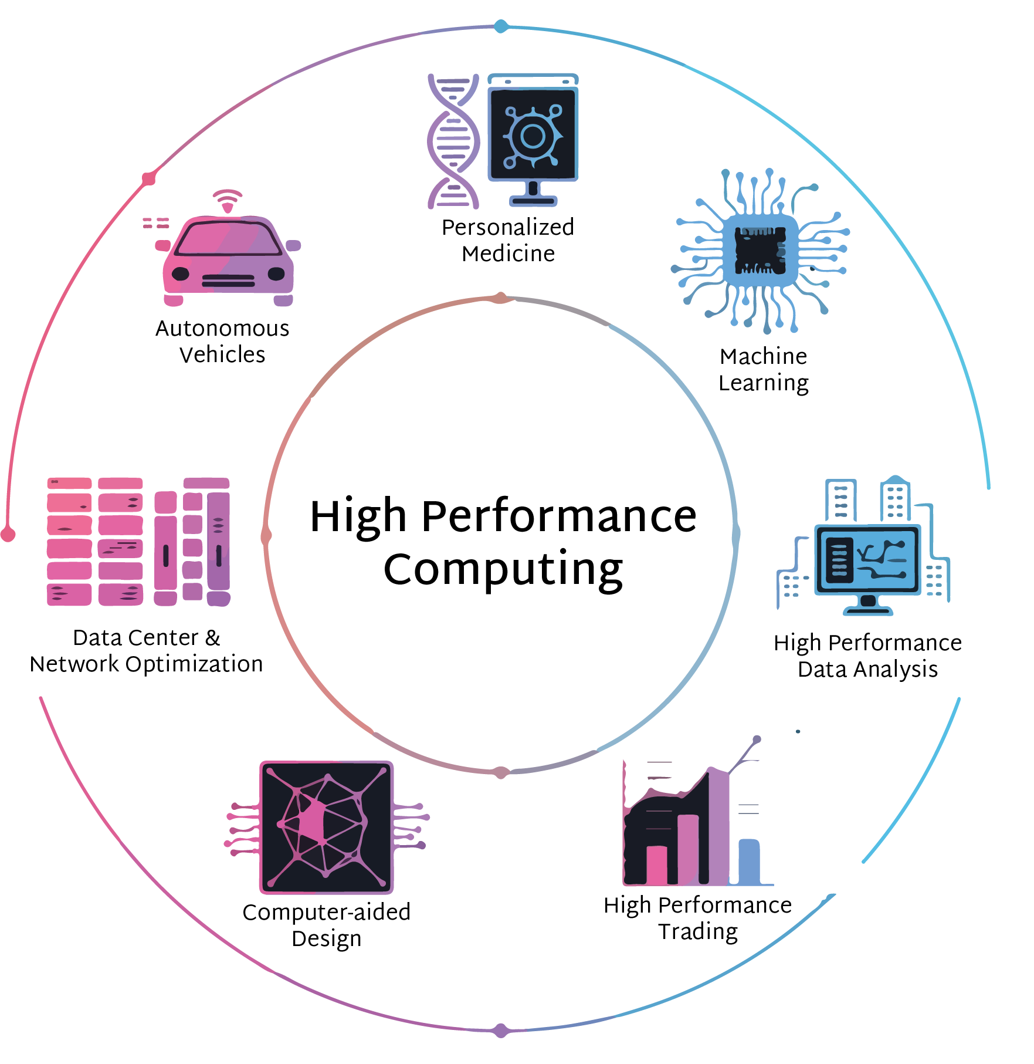
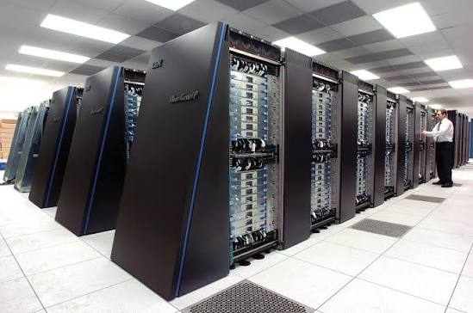


High-Performance Computing
in the Exascale Era
Claude TADONKI
Mines Paris – PSL (Paris/France)
AMRITA University (India) - August 2026

Slide 2
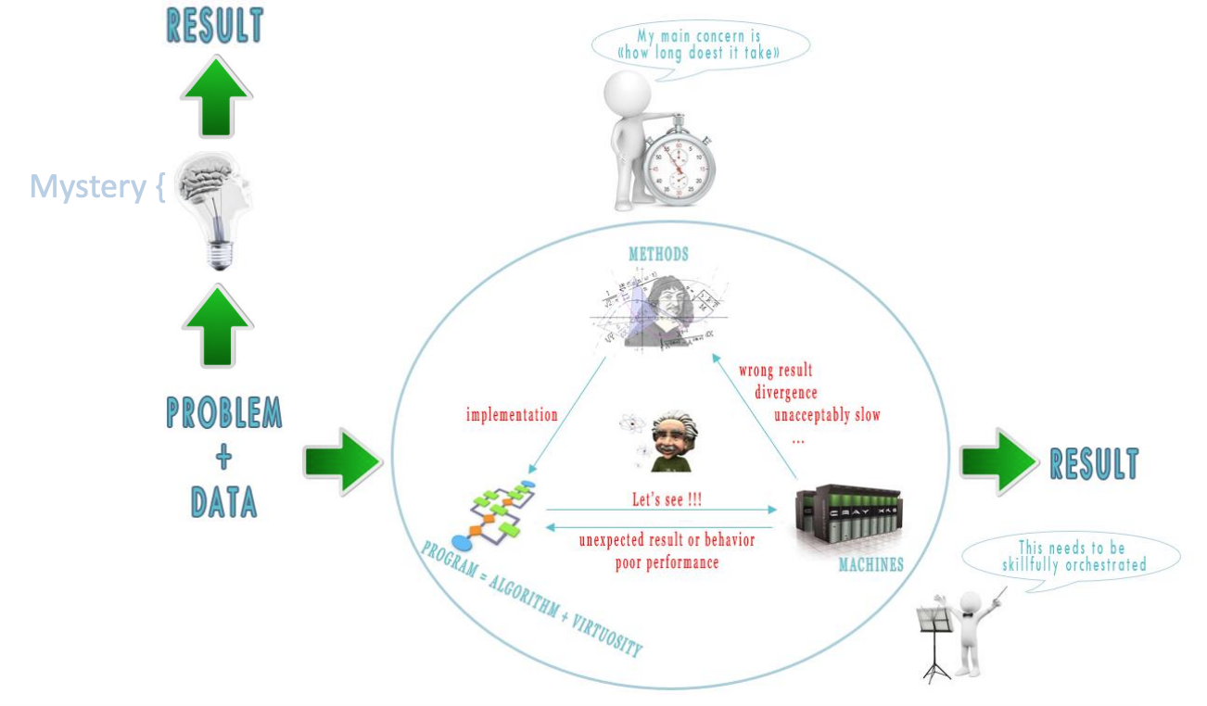

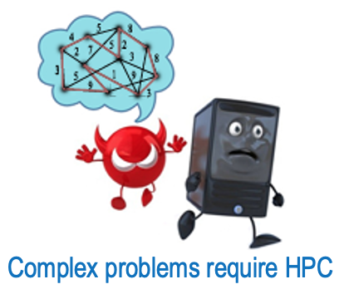

High-Performance Computing in the Exascale Era
HPC as a Combination of Method-Programming-Machines
Do you think that the best algorithm always leads to the fastest program ?
NO.
Two examples: Sorting and Linear Programming
Significant progress has been made in each of the main HPC components
A judicious combination of all HPC ingredients is essential for optimal performance
The necessary multidisciplinary interaction must be considered at the earliest
Claude TADONKI
AMRITA – India - 2026

Slide 3
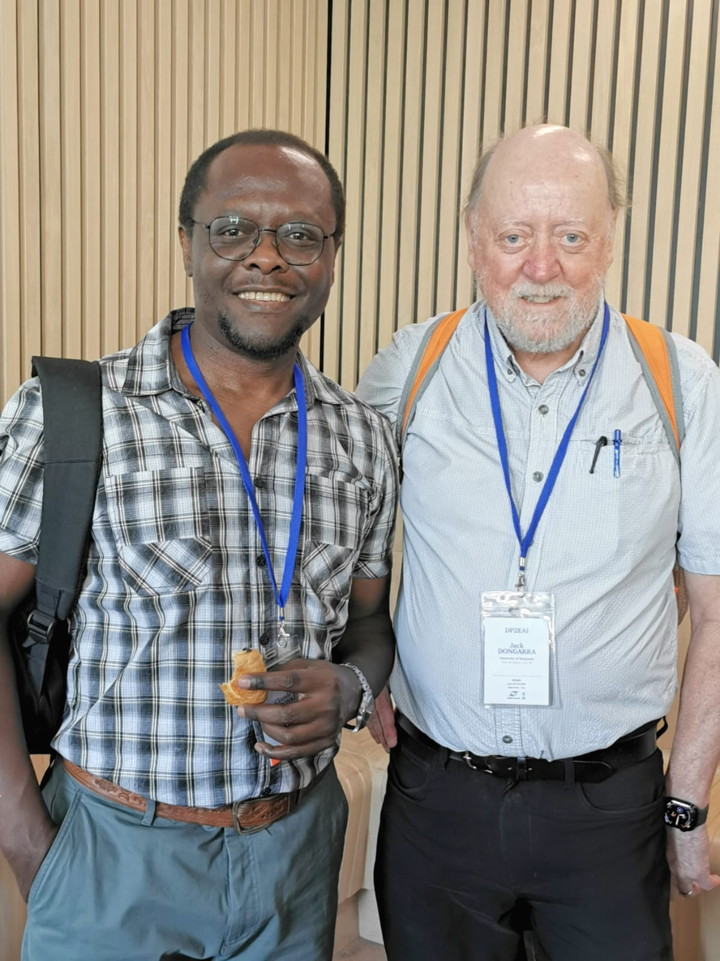
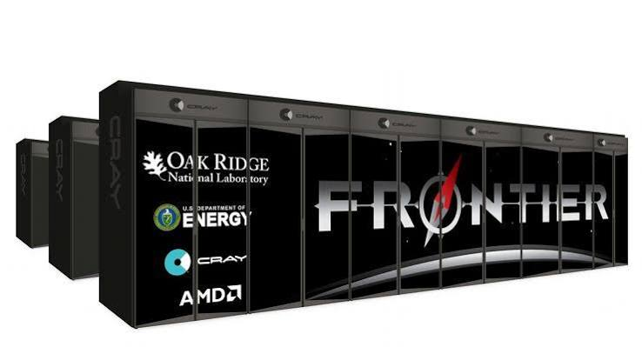
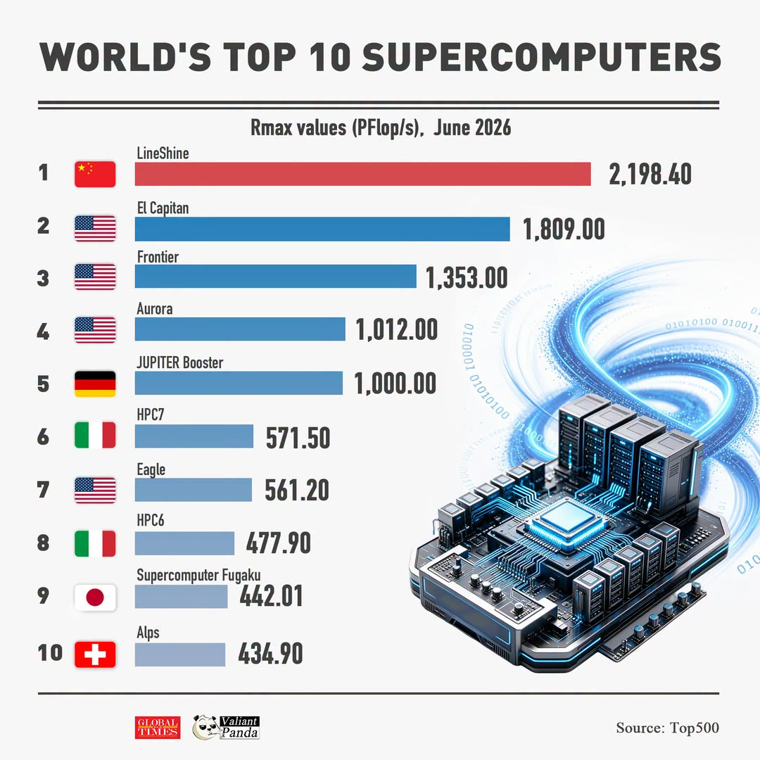
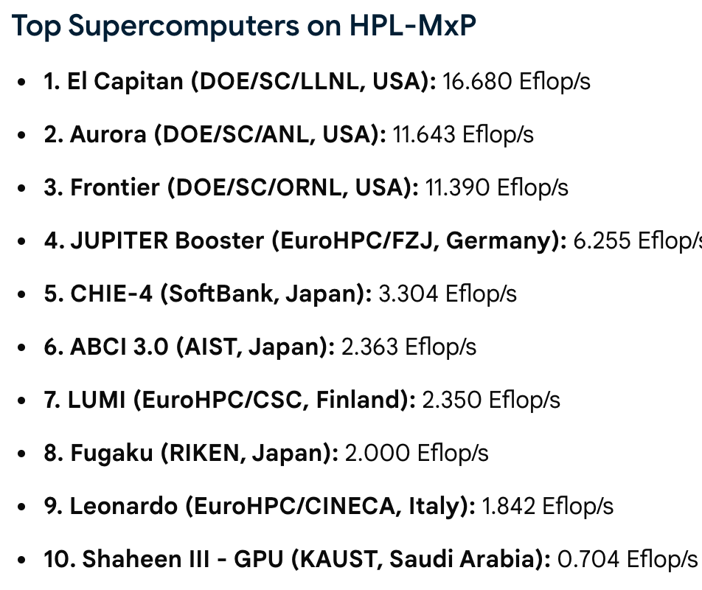
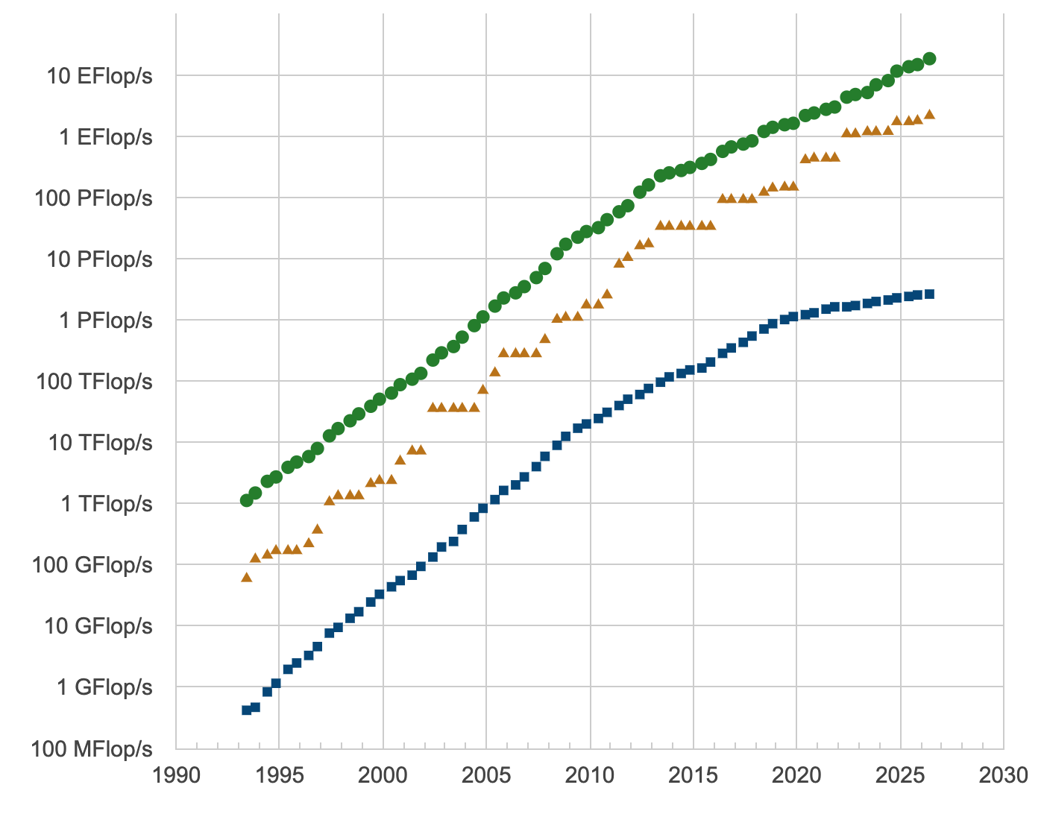

High-Performance Computing in the Exascale Era
Computing Power – Overview & Evolution
Frontier is the first Exaflop machine
Released as such in 2022 (USA)
Facts
Measurement is in double precision arithmetic
Five Exaflop machines (China¹/USA³/Germany¹)
Height of the top10 are CPU-GPU
LineShine and Fugaku are CPU-only
Jack Dongarra
(Mixed-Precision – LLM)
iPhone 17 Pro: 2.5 TFLOPS single-precision ($1,200) CRAY T3E: 1.3 FLOPS ($5 million)
Claude TADONKI
AMRITA – India - 2026

Slide 4
High-Performance Computing in the Exascale Era
Computing Power – Potential vs Reality
N° | Peak (PFlops/s) | Efficiency(%)
1 | 2,735.82 | 80
2 | 2,821.10 | 64
3 | 2,055.72 | 66
4 | 1,980.01 | 51
5 | 1,226.28 | 82
6 | 861.13 | 66
7 | 846.84 | 66
8 | 606.97 | 79
9 | 537.21 | 82
10 | 574.84 | 76
Peak is the theoretical or potential computing power
Rmax is (supposed to be) the best from measurement
Efficiency is the fraction of the peak that could be obtained
Several technical factors are involved when it comes to computational efficiency
13,789,440 cores
11,3400,000 cores
9,066,176 cores
9,264,128 cores
≈ 5M
≈ 3.4M
≈ 2M
≈ 3M
Obtaining the highest fraction of the peak performance of a high-speed machine is the typical technical challenge of an HPC expert.
≈ 8M
≈ 2M
Claude TADONKI
AMRITA – India - 2026

Slide 5

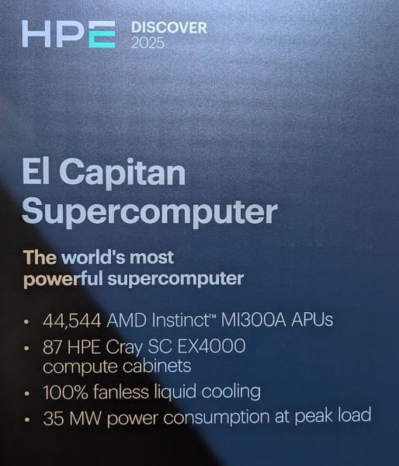
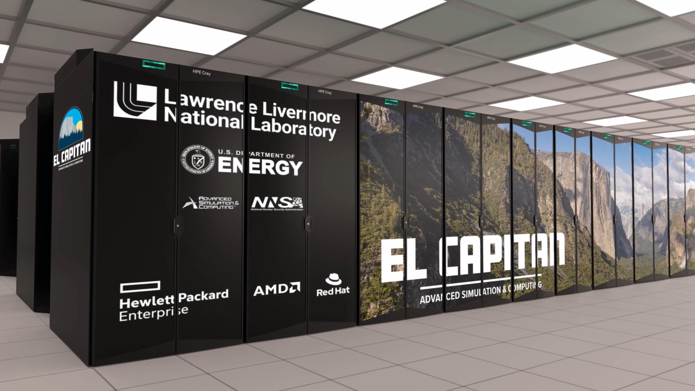
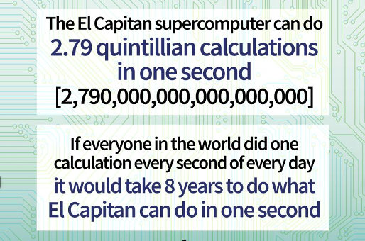
High-Performance Computing in the Exascale Era
Computing Power –2e World Fastest Supercomputer
El Capitan
Number of cores: 11,340,000
Configuration: CPU - GPU
Peak (PFlops/s): 2,821.10
Rmax (PFlops/s): 1,809.00
Power(kW): 29,685
Annual electricity bill: $14-30 million
4 MI300A / Node – 11,136 nodes – 87 Cabinets
Claude TADONKI
AMRITA – India - 2026

Slide 6

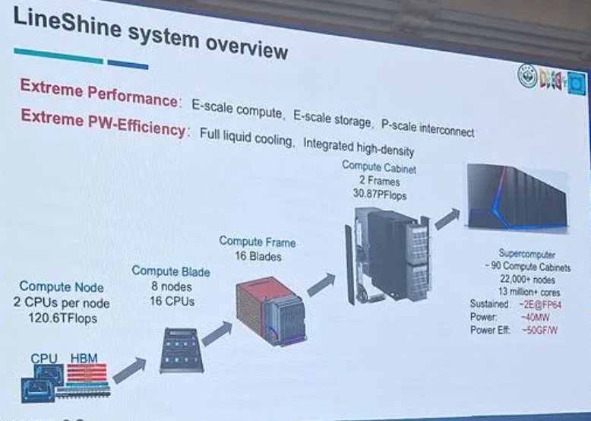
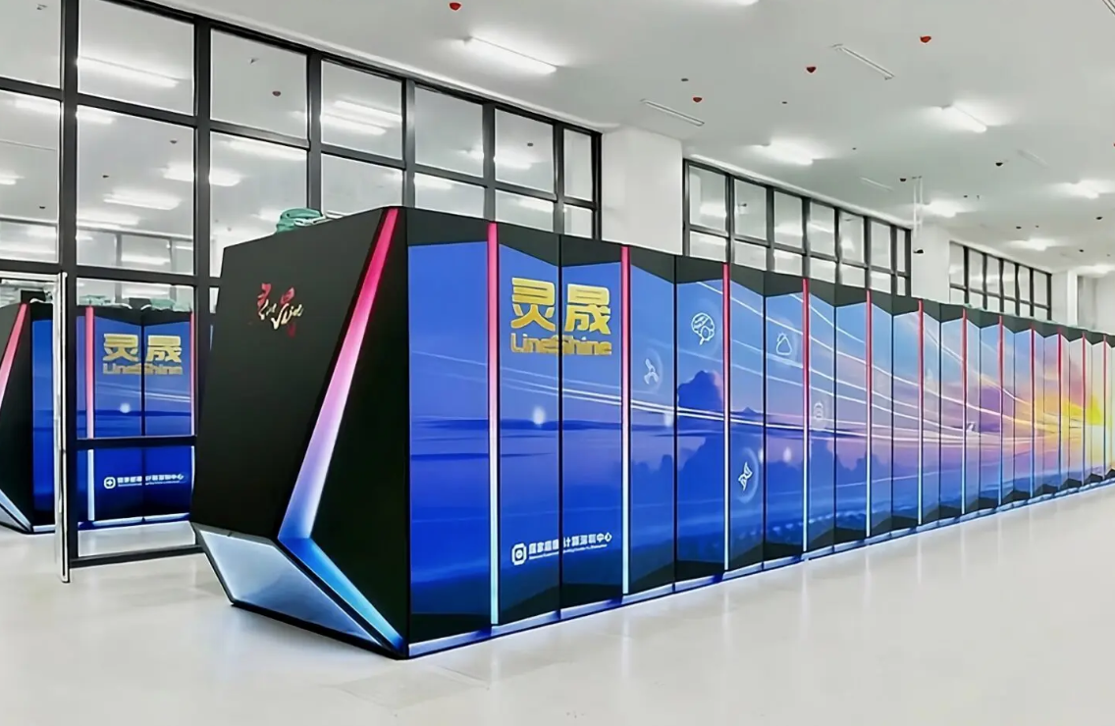
High-Performance Computing in the Exascale Era
Computing Power – World Fastest Supercomputer
LineShine
Number of cores: 13,789,440
Configuration: CPU only
Peak (PFlops/s): 2,735.82
Rmax (PFlops/s): 2,198.40
Power(kW): 42,220
Annual electricity bill: $20-40 million
Claude TADONKI
AMRITA – India - 2026

Slide 7
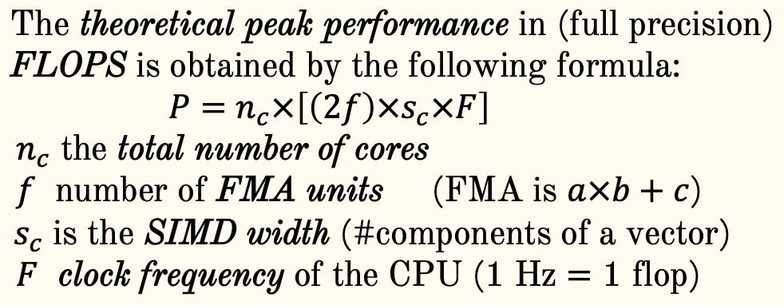
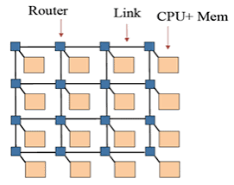
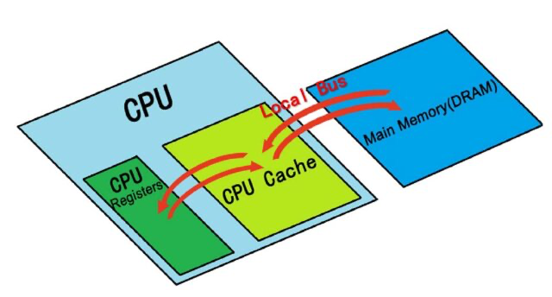
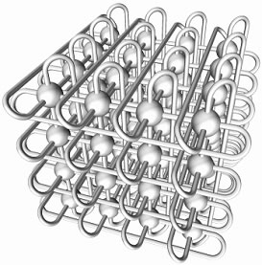
High-Performance Computing in the Exascale Era
Computing Power – Understanding Performance Data
Facts
A computing cluster is made up with several compute nodes
Compute nodes exchange data through a physical network (interconnects)
A typical computation on a CPU-core involves memory read/write
Peak performance does not consider any non-computing mechanism
Claude TADONKI
AMRITA – India - 2026

Slide 8
High-Performance Computing in the Exascale Era
Computing Power – Questions & Discussions
Do you think about a supercomputer with a weak efficiency (like Aurora with 50%)?
Aurora is 2e on HPL-MxP (mixed-precision), so the efficiency depends on the application and the execution model.
Is the reported efficiency for each machine necessarily the best (note that the full machine is considered) ?
NO.
Running on a subset of the machine might yield a better performance.
Claude TADONKI
AMRITA – India - 2026

Slide 9
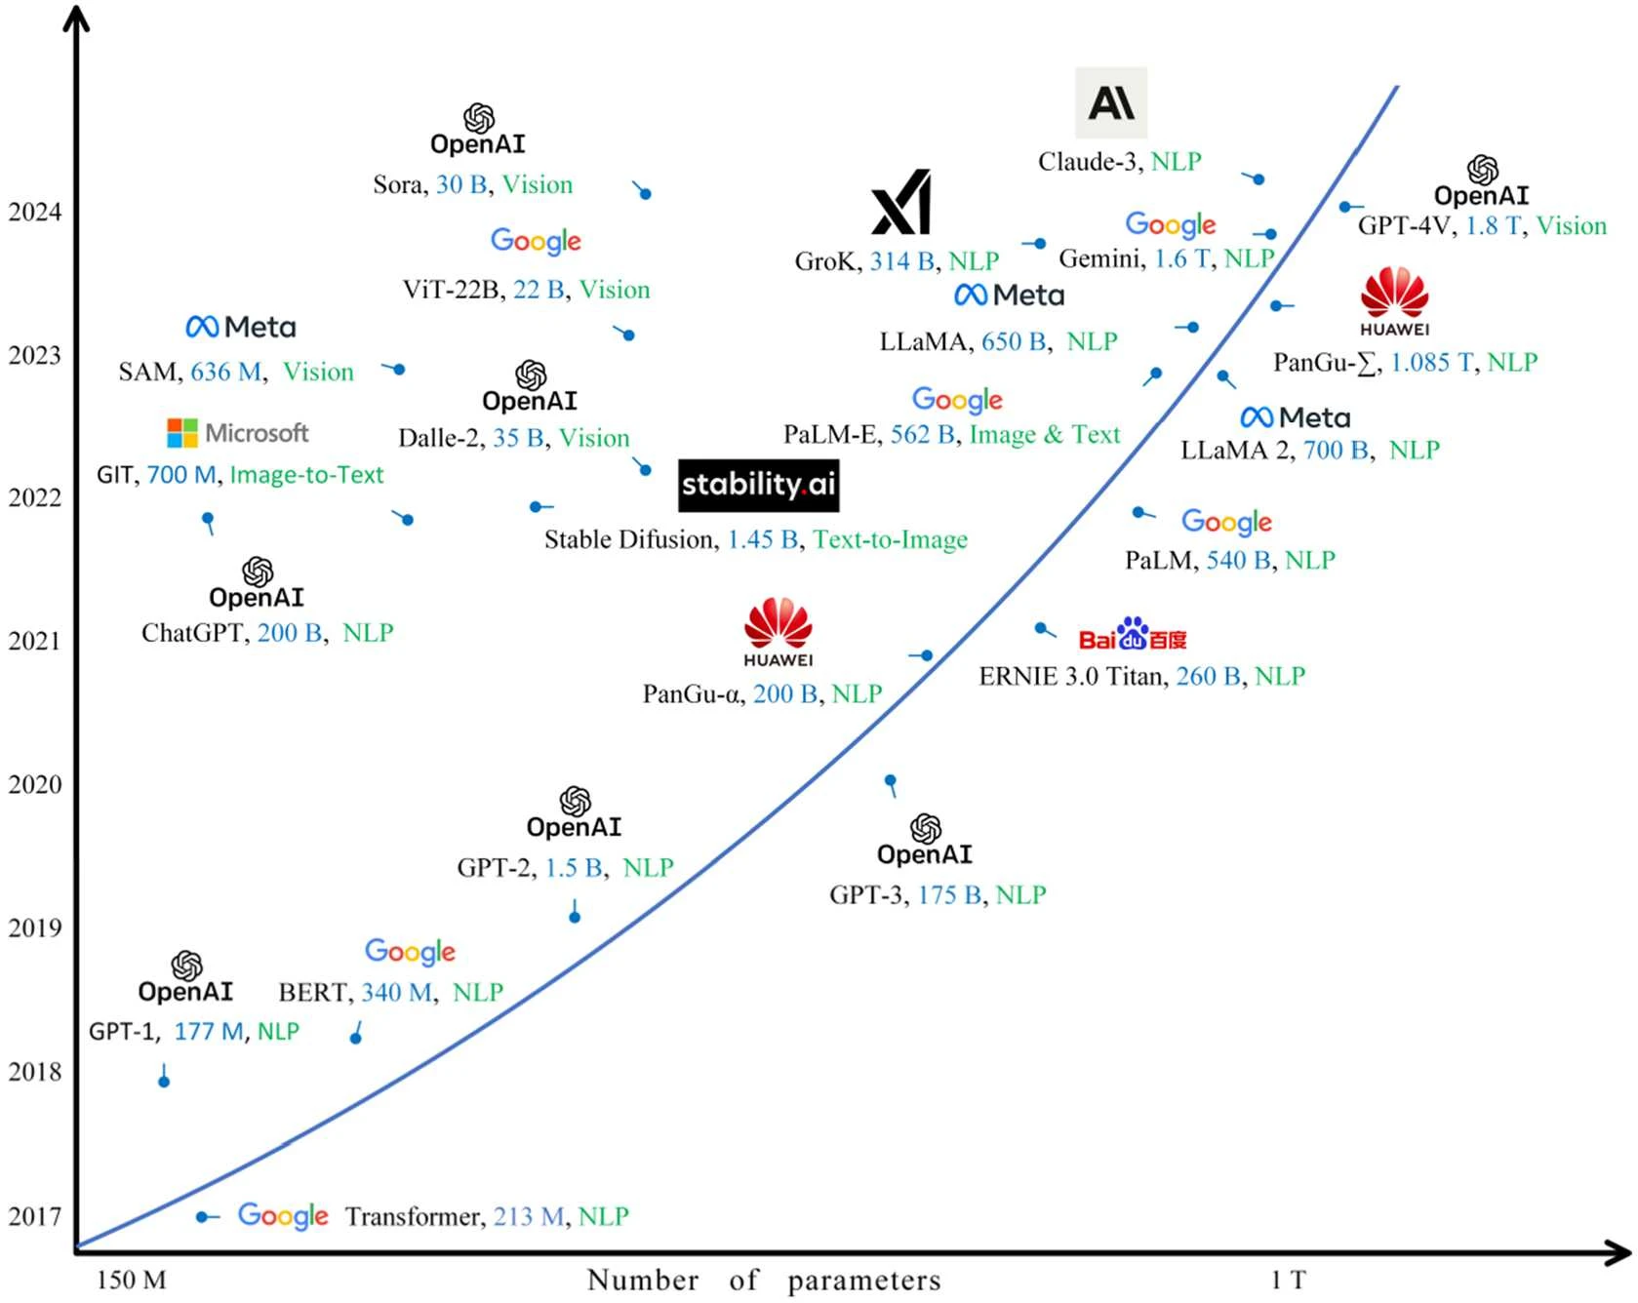
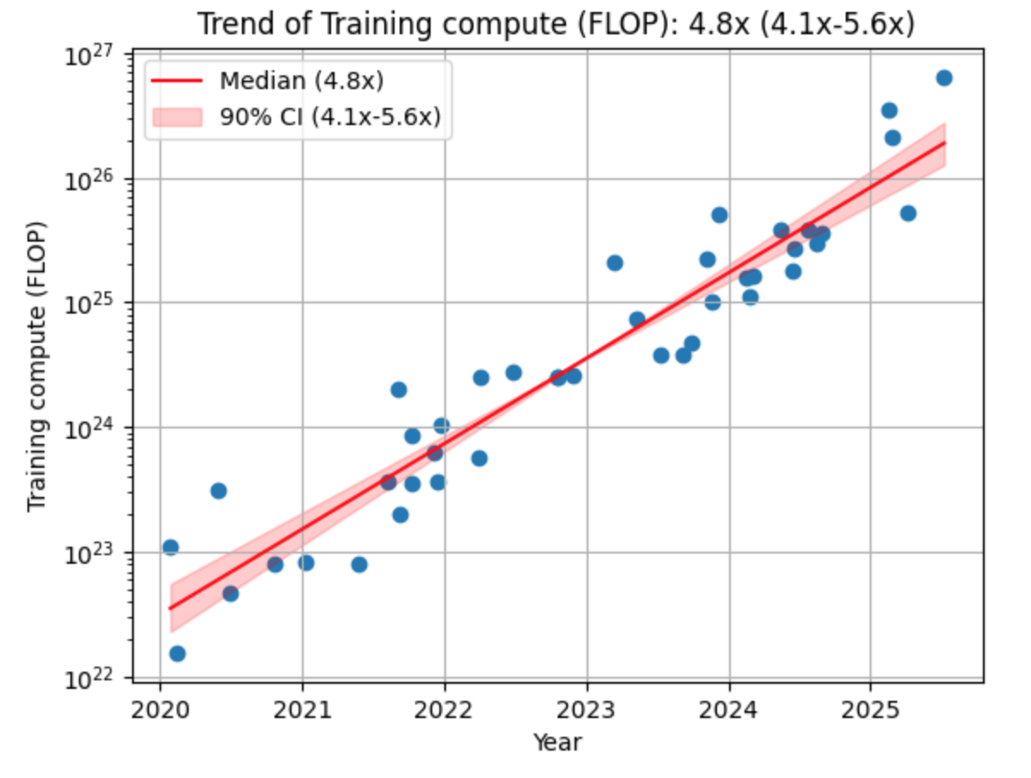
High-Performance Computing in the Exascale Era
HPC Applications - LLMs
Grok 4: 5x10²⁶ FLOPS = 5×10⁸ EFLOPS
GPT-5: 6.6x10²⁵ FLOPS = 6.6×10⁷ EFLOPS
ChatGPT is close to a billion of requests per week
2024: 100M - 2025: 400M - 2026: 900M
ChatGPT is now powered by GPT-5.6 ( ≈3T params)
Courtesy: Xiaoguang et al.
An overview of Large AI Models and their Applications
GPT-3 training: 3.5 GPU-centuries!!!
Claude TADONKI
AMRITA – India - 2026

Slide 10
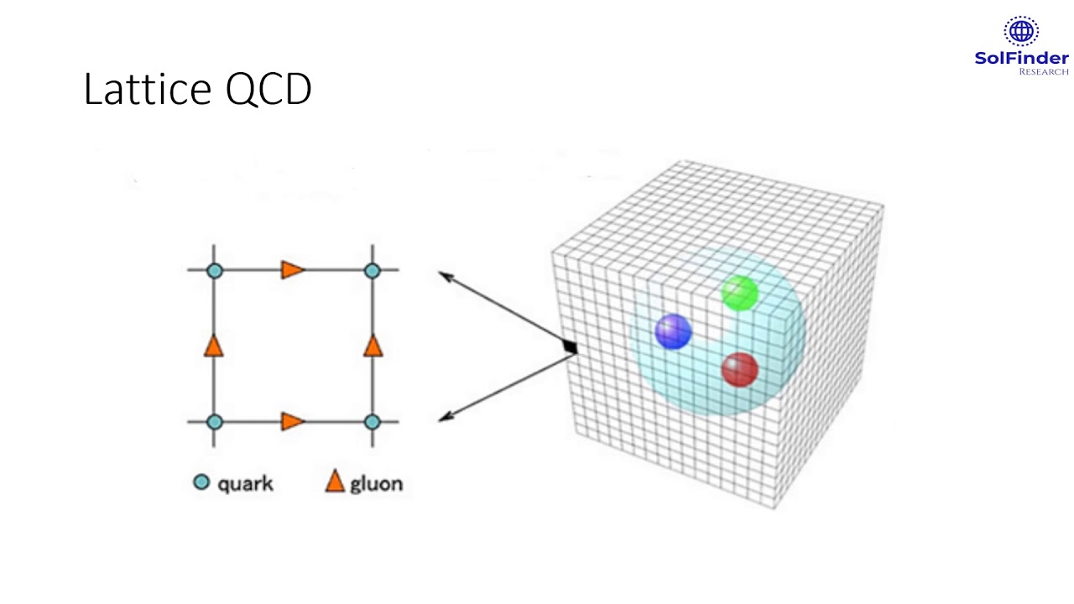
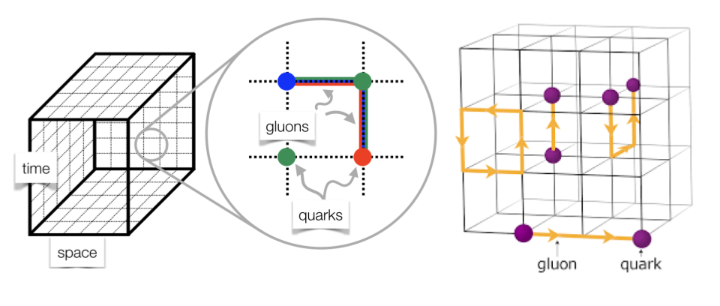
High-Performance Computing in the Exascale Era
HPC Applications – Numerical Simulation
Lattice Quantum ChromoDynamics (LQCD)
Lattice Quantum Chromodynamics (LQCD) is a numerical method used by physicists to solve the physics of quarks and gluons at low energies.
It is a Monte-Carlo numerical simulation aiming at understanding the origin of mass and stability of matter (right after the Big-Bang).
The main computational kernel is the evaluation of the so-called Wilson-Dirac operator given by the following equation
It is a 4D space-time simulation specified by its parameters L_{x}, L_{y}, L_{z}, L_{t} and associated data (double-precision and complex numbers).
Tremendous volume of data to load/write (from memory) and exchange (between processors) iteratively.
c
Physicists expect meaningful results from 2⁹×2⁹×2⁹×L_{t} = 2²⁷×L_{t}
Claude TADONKI
AMRITA – India - 2026

Slide 11
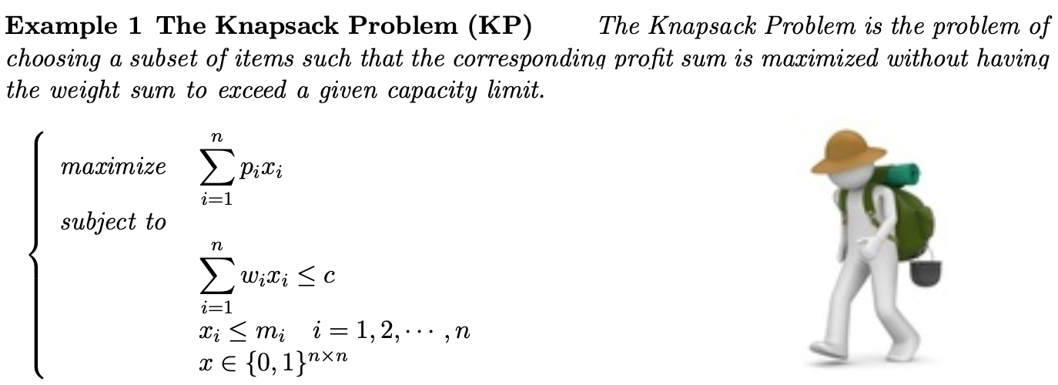
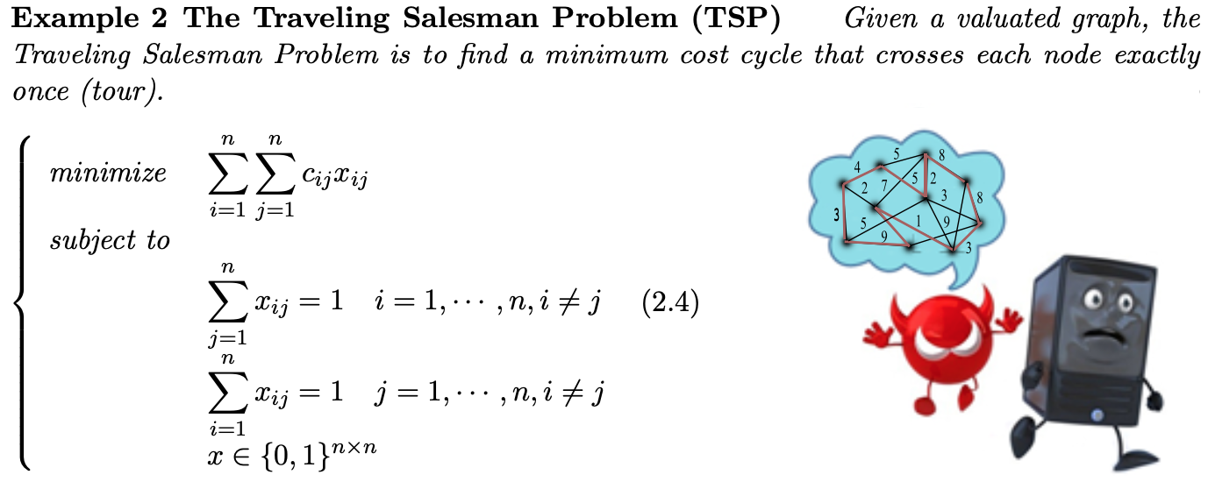
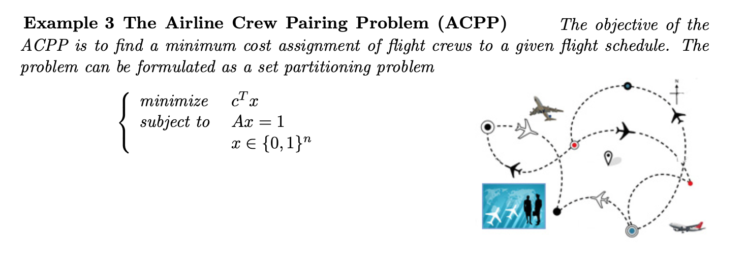
High-Performance Computing in the Exascale Era
HPC Applications – Combinatorial Optimization
Combinatorial optimization is known as the benchmark for the most difficult computational problems.
The Traveling Salesman Problem is one of the most difficult combinatorial problem.
Even with small sizes such as 30 nodes, the current fastest supercomputer would required tens of years with the brute-force algorithm.
Claude TADONKI
AMRITA – India - 2026

Slide 12
High-Performance Computing in the Exascale Era
HPC Applications – Questions & Discussions
What other application areas do you see for HPC?
Genomics, weather forecasting, data science, seismic analysis, molecular dynamics, nuclear physics, cosmology, ...
Can you give some examples of areas that strongly depend on HPC ?
Large-scale AI, high-precision simulation, quantitative trading, cutting-edge operational research, ....
Claude TADONKI
AMRITA – India - 2026

Slide 13
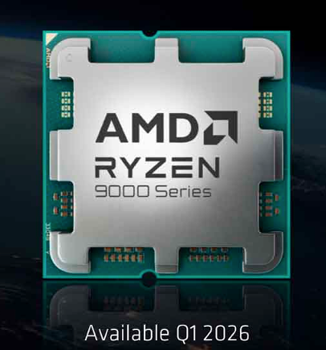
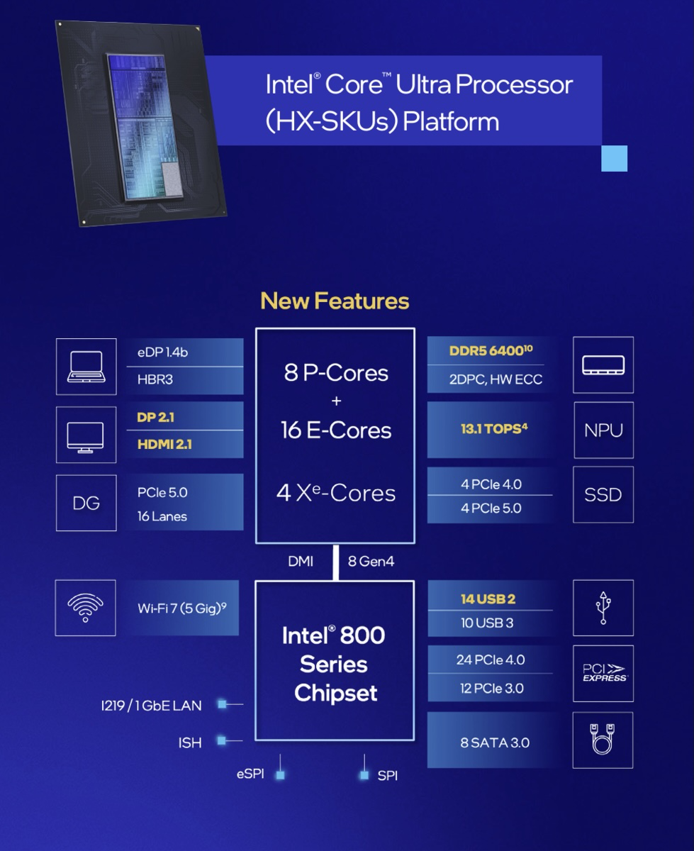
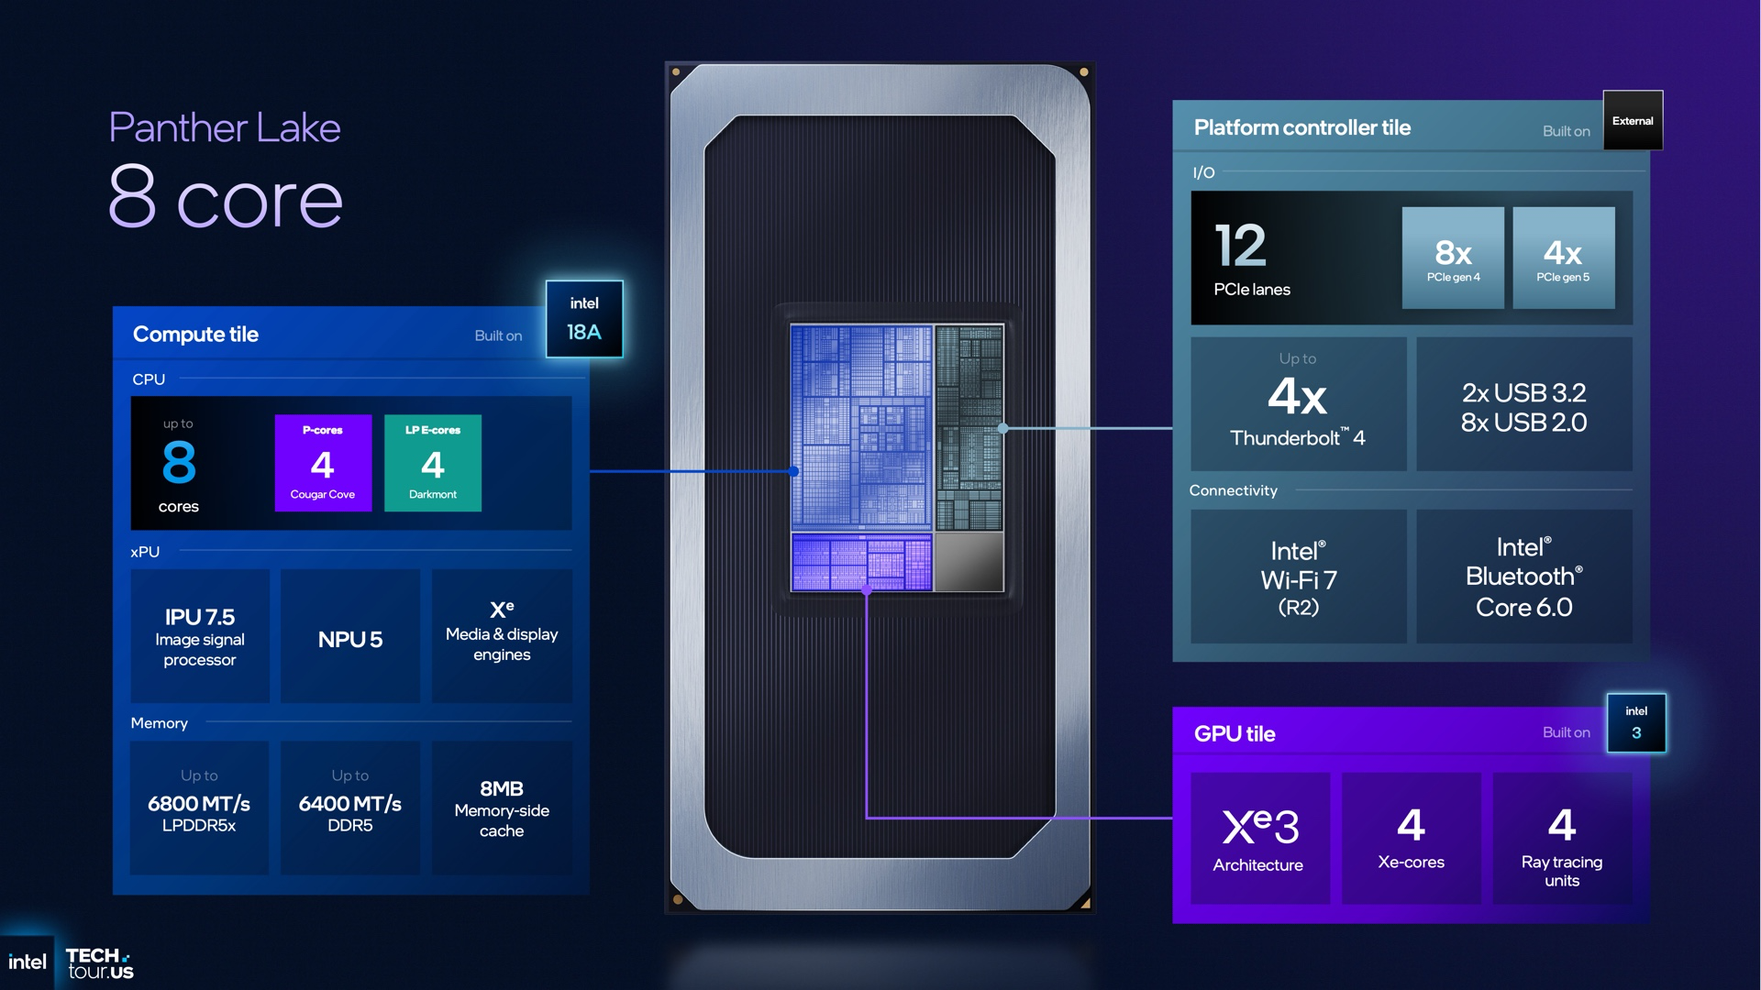
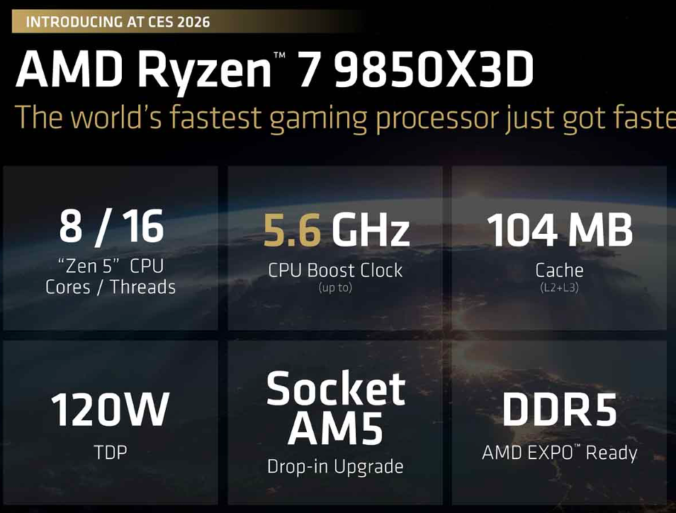
High-Performance Computing in the Exascale Era
Heterogeneity – Standard CPU
Ordinary CPU remain the basic HPC computing device.
Larger number of cores (P-cores/perf; E-cores/energy; Xe-cores/extension)
Wider SIMD (vector registers and instructions set)
Bigger and faster memory (with a complex hierarchical structure)
Better instruction pipeline
More specialized units (computation and I/O)
Energy-aware
Desktop
Laptop
Claude TADONKI
AMRITA – India - 2026

Slide 14
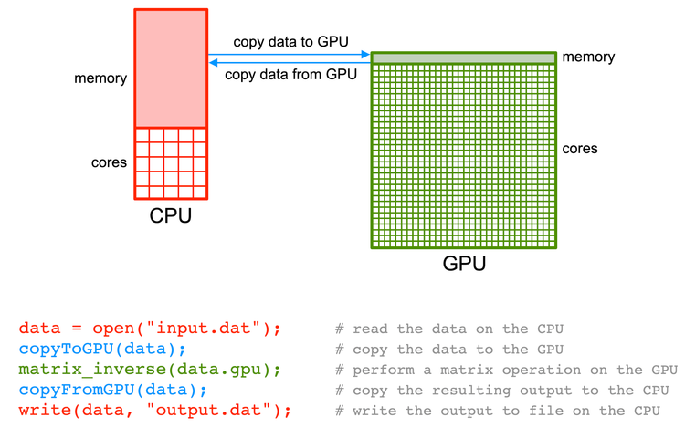

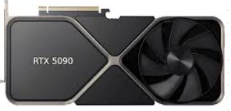
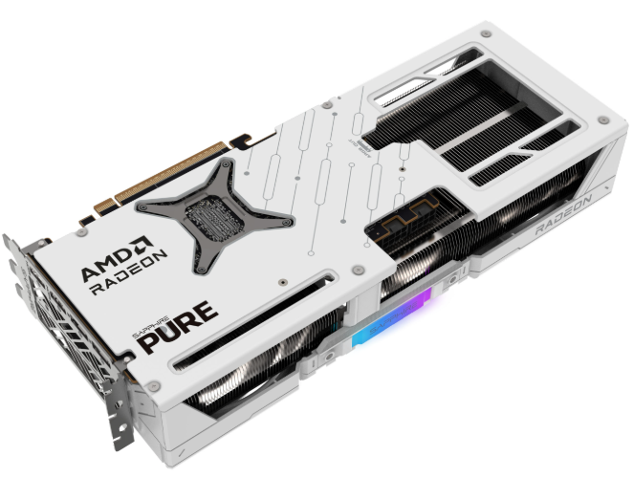
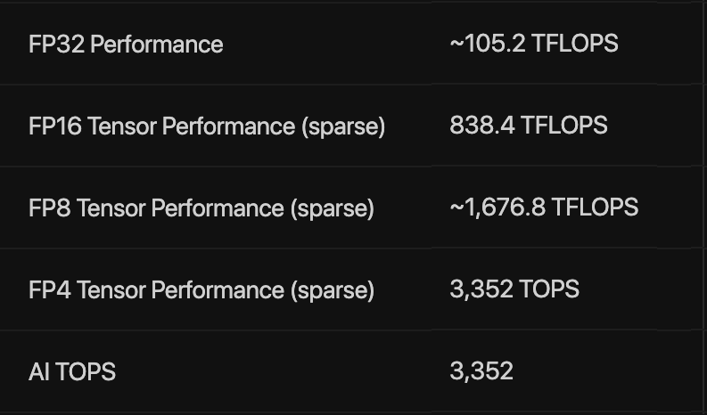
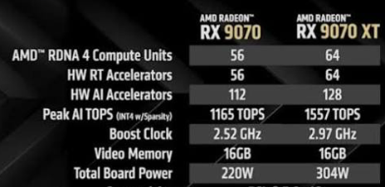



High-Performance Computing in the Exascale Era
Heterogeneity – Accelerators
The main accelerators commonly considered are GPUs and FPGAs.
Typically run under the coordination of an ordinary CPU
Large number of cores (thus so-called many-core processor)
Very fast on regular computation (highly parallel & deep pipeline)
Faster on low-precision arithmetic (improved on high-precision)
Nowadays considered as energy-efficient solutions
Newer GPUs are becoming more CPU-like
Family | CUDA Cores | TFLOPS FP32 - FP16
Fermi | 512 | 1.5
Kepler | 1,536 | 3.0
Pascal | 2,560 | 9.0
Volta | 5,120 | 15 - 125
Ampere | 6,912 | 20 - 312
Hopper | 16,896 | 67 - 1000
Blackwell | 20,800 | 75 - 2250
Blackwell
https://researchcomputing.princeton.edu/support/knowledge-base/gpu-computing
AMD RADEON
Image/Video Processing
AI
ML Training/Inference
Claude TADONKI
AMRITA – India - 2026

Slide 15
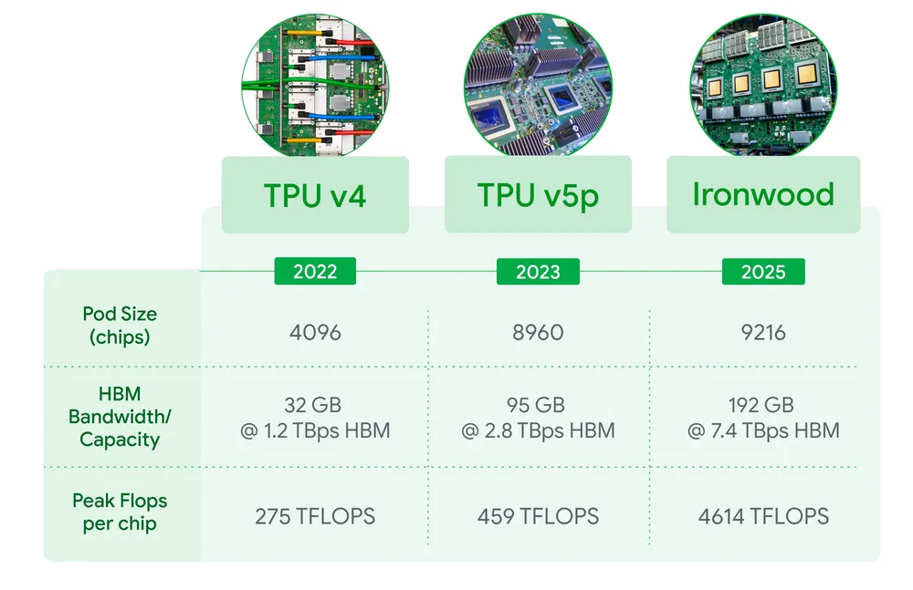
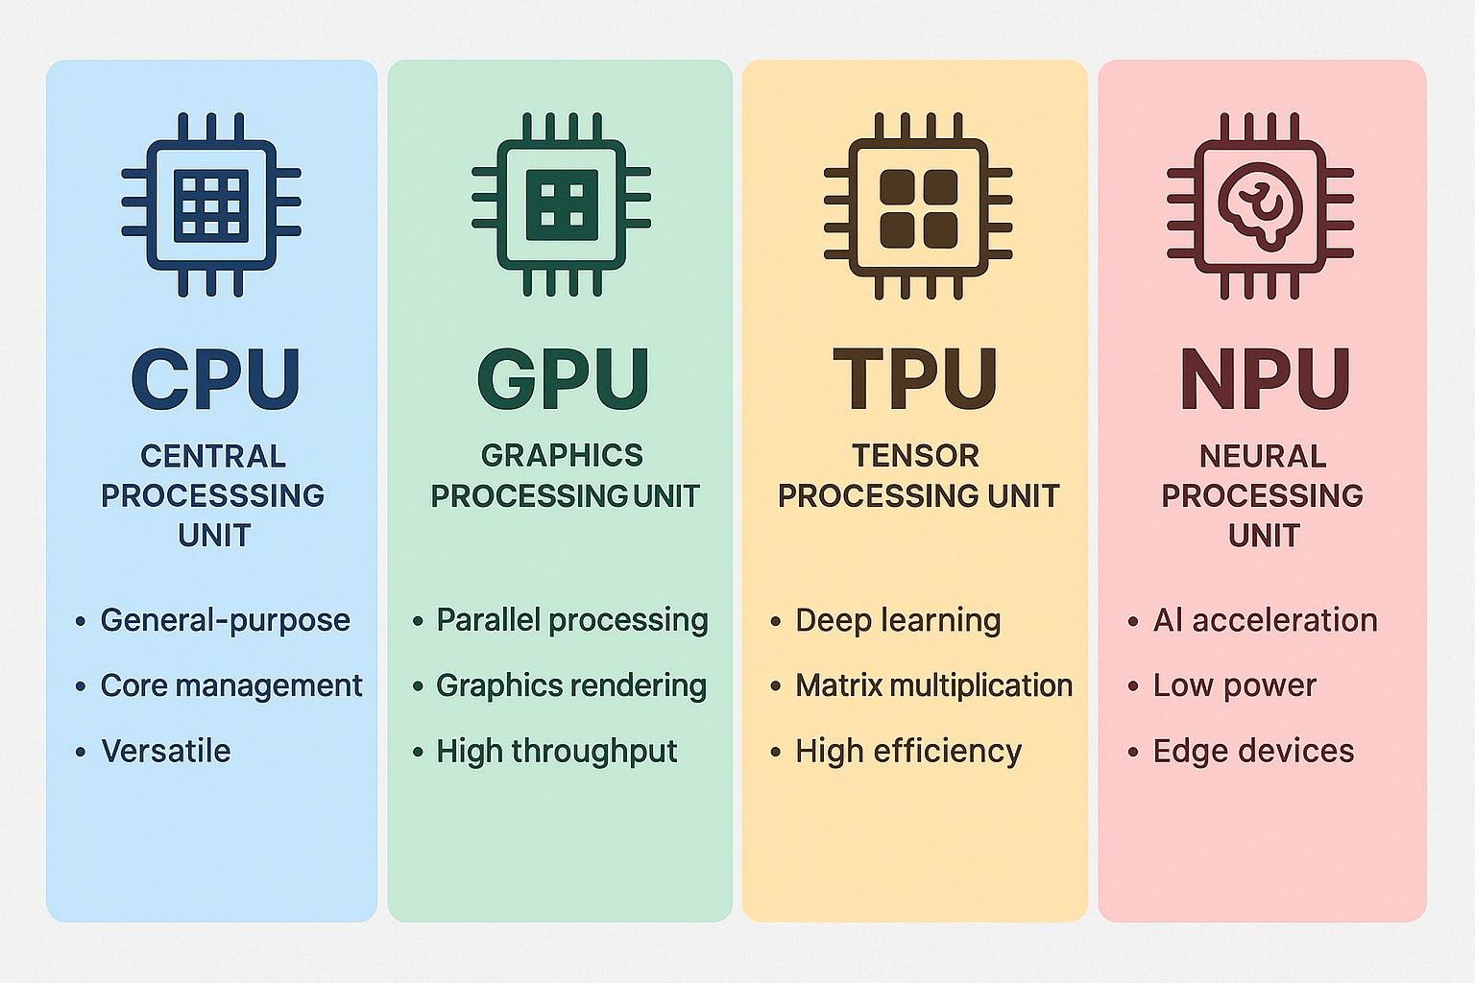
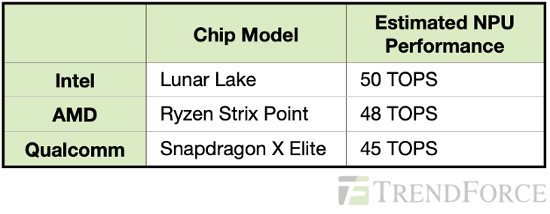
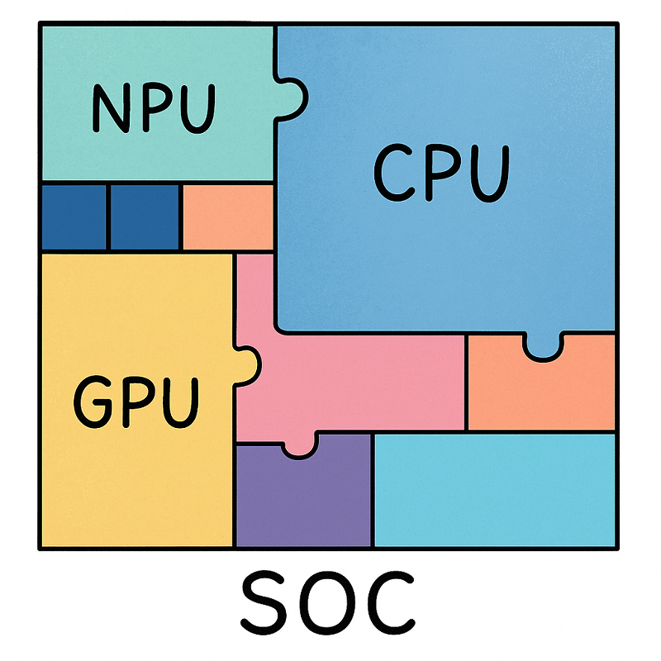
High-Performance Computing in the Exascale Era
Heterogeneity – Neural/Tensor Processing Units
TPU (Tensor Processing Unit)
  Application-specific integrated circuit (ASIC) designed by Google
  Highly efficient on matrix multiplication and addition
  Based on the systolic paradigm
  INT8 Precision (quantization) for ML/DL inference
  Cloud/Edge device
NPU (Neural Processing Unit)
  Specialized computer chip for accelerating AI/ML workloads
  Energy-efficient (compared to CPU and GPU)
  Much more flexible than a TPU
  Can compute locally without offloading to a remote server
  Intel (Intel NPU); AMD (Ryzen AI NPU); Apple (Apple Neural Engine)
  Qualcomm (Hexagon NPU); Samsung (Exynos AI); …
Claude TADONKI
AMRITA – India - 2026

Slide 16
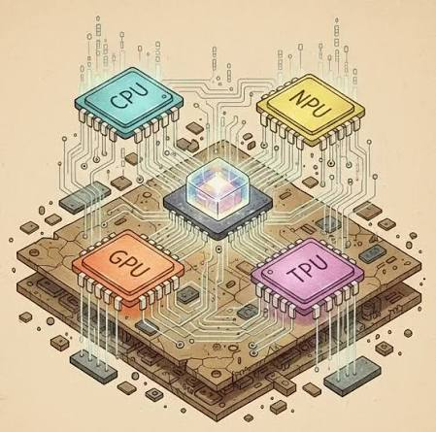
High-Performance Computing in the Exascale Era
Heterogeneity – Questions & Discussions
What is the key to ease the programming of all these devices ?
Compilers; APIs; Libraries
What are the potential operational issues that you can identify ?
Portability; Debugging; Updates
Claude TADONKI
AMRITA – India - 2026

Slide 17
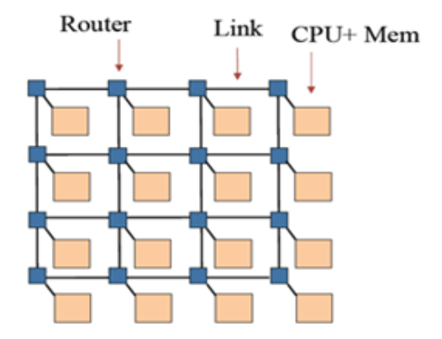
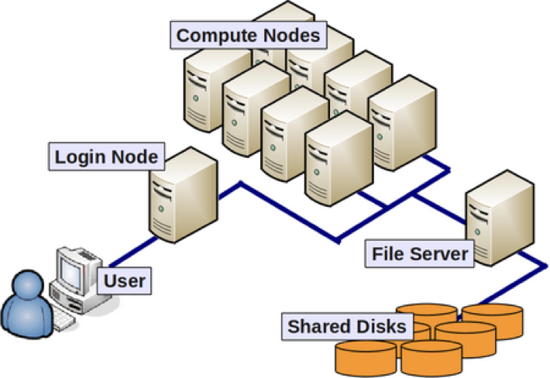
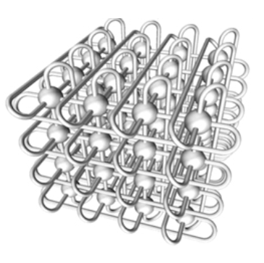
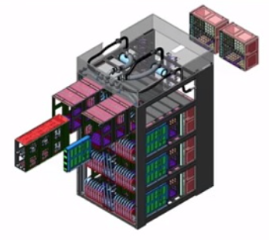
High-Performance Computing in the Exascale Era
Programming Models – Distributed Memory Parallelism
The implementation of this model is for fully independent compute nodes.
  Typical way of running on clusters and supercomputers
  Each node has/manages its own memory
  Data are shared through explicit interprocessors communication
  Ordinary Programming Language + Message Passing Library (MPI)
Key aspects for performance include
  The overhead of data exchanges (packaging & network topology)
  Synchronization between the compute nodes
  Load imbalance
Distributed Memory Parallel Machine
Typical Packaging
Torus Topology of Fugaku Supercomputer
Claude TADONKI
AMRITA – India - 2026

Slide 18
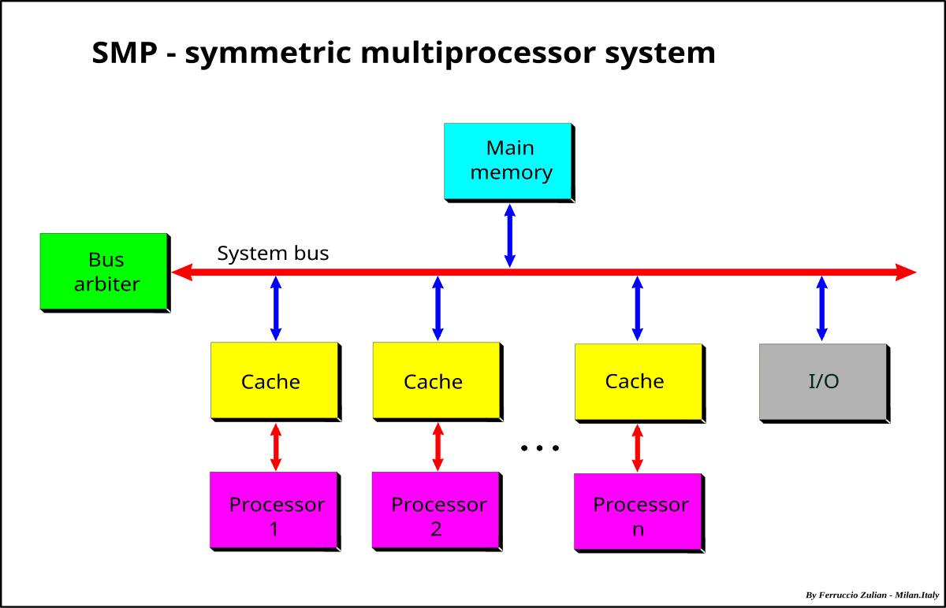
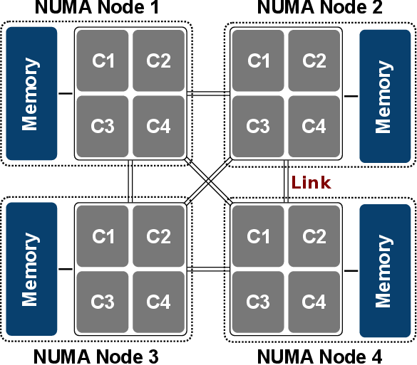
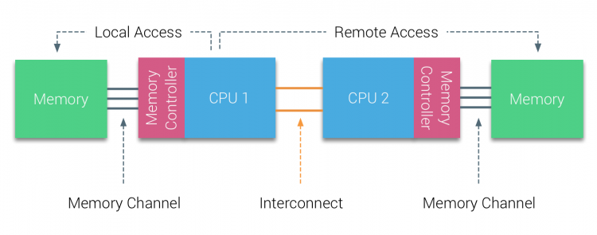
High-Performance Computing in the Exascale Era
Programming Models – Shared Memory Parallelism
The implementation of this model is for independent CPU-cores sharing a common memory.
  Typical way of running on multicore processors
  Each CPU-core has equal access to the common main memory
  Both central RAM and address space are shared (same memory references)
  Ordinary Programming Language + Multithreading Library (Pthreads)
Key aspects for performance include
  The overhead of concurrent memory accesses (also hierarchy of the caches)
  Thread scheduling and dynamic management by the OS
  Synchronization between threads (mutex)
  Load imbalance
  NUMA effect (if applicable)
Claude TADONKI
AMRITA – India - 2026

Slide 19
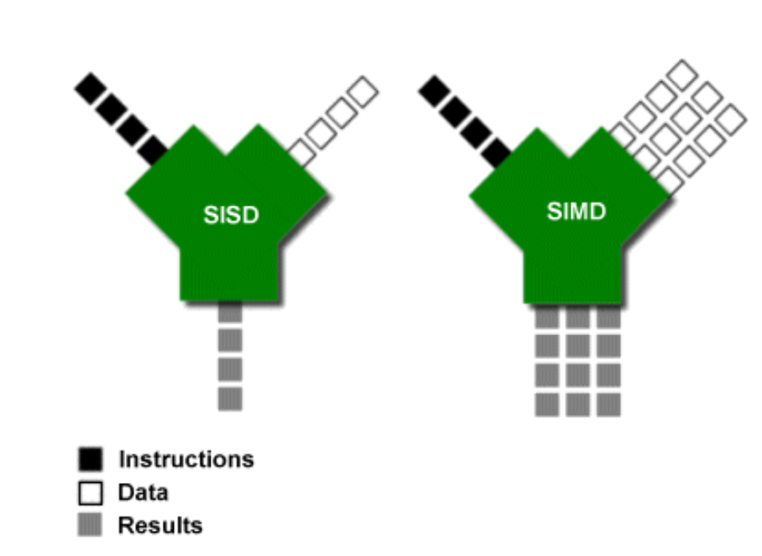
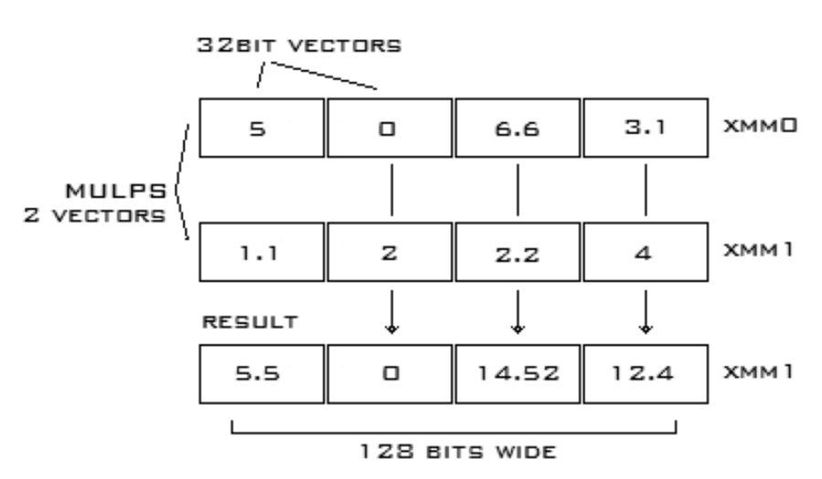
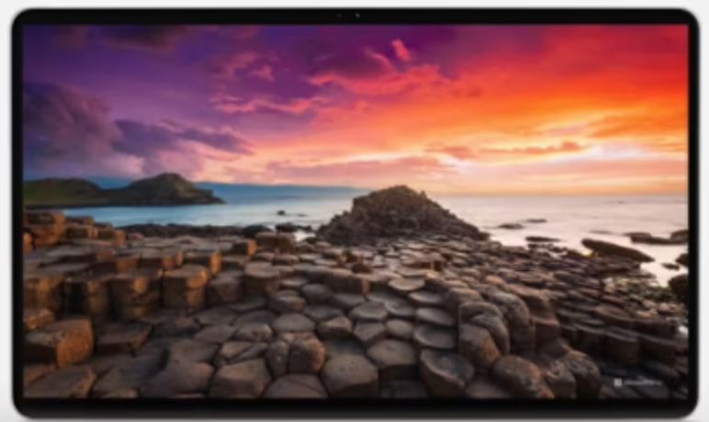
High-Performance Computing in the Exascale Era
Programming Models – SIMD Parallelism
This is Single Instruction Multiple Data paradigm, also referred as Vector Computing.
  Handled on standard CPUs through vector units and vector registers
  Each CPU-core has its own vector units/registers and can perform SIMD
  Has been extended from graphical computation to any arithmetic instruction
  SIMD instruction types include arithmetic, shuffling, memory read/write
  Ordinary Programming Language + SIMD Library (SSE; AVX)
  Vector register width: 128bits (SP:×4 DP:×2); 256 bits (SP:×8 DP:×4); and 512 bits (SP:×16 DP:×8)
Key aspects for performance include
  Memory alignment (critical for direct access)
  Data locality (ideally contiguous)
  Lower precision (more vector-components)
  Compute-bound (the effect is on the calculation)
Very effective in image processing
Claude TADONKI
AMRITA – India - 2026

Slide 20
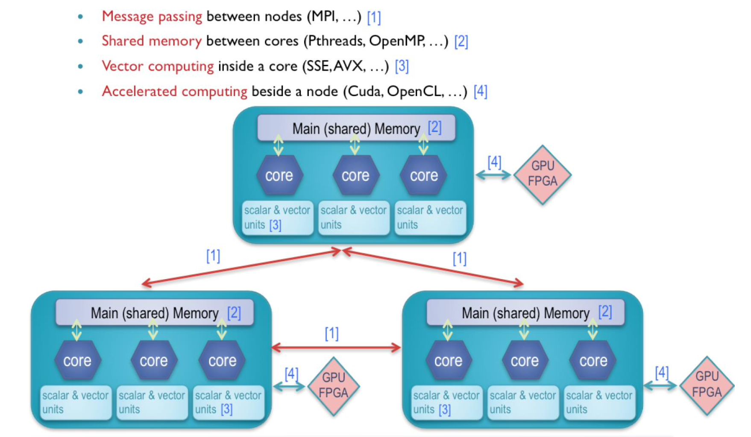
High-Performance Computing in the Exascale Era
Programming Models – Hybrid Parallelism
Claude TADONKI
AMRITA – India - 2026

Slide 21

High-Performance Computing in the Exascale Era
Programming Models – Questions & Discussions
Do you think that a compiler can perform all levels of parallelism ?
NO. Until now, only vectorization is tried by the compiler whenever possible.
Can we run a distributed-memory parallel program on a single multicore processor ?
Yes, although the central RAM is actually shared.
Claude TADONKI
AMRITA – India - 2026

Slide 22





High-Performance Computing in the Exascale Era
Getting Access to an HPC Infrastructure
Locally (you own one)
Current et Next-Generation desktop processors might provide sufficient level of computing power, provided (one more time) that applications are implemented considered all lever of performance (multicore/SIMD/GPU/NPU/TPU)
Pros and cons of private/local resources vs shared/remote ones ?
Private: easy/full access : costs
Shared: cost/management restricted/partial access
Remotely (from an HPC Resources Center)
This can be an HPC cluster of an institution or a supercomputer of an HPC Center that is made available to the community through user accounts and means of remote access.
Cloud (through a Cloud Provider)
Also a remote access but with a virtualized approach. There you can get infrastructures (IaaS), platforms (Paas) and software (Saas) on a flexible basis.
Claude TADONKI
AMRITA – India - 2026

Slide 23



High-Performance Computing in the Exascale Era
Support Tools: Compilers – Libraries - Profilers
Compilers: Essential to get a functional binary or a version that is compatible with the device. Their optimization functionality is crucial for performance.
Source-to-source compilers are very useful to
seamlessly design specific versions (multicore/GPU).
Cite one of the most popular source-to-source compiler and its major features.
OpenMP.
Generates Multithread, SIMD, and GPU(Cuda)
Libraries: Very important to get access to some hardware/system features and useful kernels.
Common key libraries are related to OS, math,
parallel scheduling, APIs, …
What kind of useful information can provided a profiler.
Profilers: It is not always sufficient to understand performance results from prediction models that are typically based on static hypothesis. Profilers are useful to get detailed information about runtime events and their associated costs.
Can spot memory leaks, poor cache efficiency, idle states, load imbalance.
Claude TADONKI
AMRITA – India - 2026

Slide 24




High-Performance Computing in the Exascale Era
Performance Aspects: Absolute/Sustained Performance
Absolute Performance, also called Peak Performance, is the potential computing power of the processor/machine.
It is an upper bound of what can be expected from a computing system based on its technical characteristics.
FUGAKU Supercomputer
$$n_{c }=7630848 ; f=2 ; s_{c }=\frac{512}{64} ;F=2.2$$
$P= 7630848×4×8×2.2=537.21$PFLOPS.
Relative Performance, also called Sustained Performance, is the measured computing speed of the machine.
It therefore includes all operational realities (hardware and system) related to the computation such as:
Memory accesses; branching; CPU frequency variation; idle states; contention on shared resources; synchronization;
overhead of data exchanges; load imbalance;
There is always a gap between sustained performance and absolute performance.
The main objective of performance optimization is to get the highest computing speed (close the aforementioned gap).
Claude TADONKI
AMRITA – India - 2026

Slide 25


High-Performance Computing in the Exascale Era
Performance Aspects: Speedup & Scalability
The speedup refers to ratio between the execution time of a given program and its transformed one.
When it comes to parallelism, it tells how good is the parallelization.
Speedup $σ(p)=\frac{T_{s}}{T_{p}}$ Efficiency $e= \frac{σ(p)}{p}ε]0,1]$
$T_{s}:sequential execution time T_{p}:parallel execution time$
$p:number of processors$
The scalability refers to the ability of a program to keep its efficiency with a growing size of computing resources or an increasing size of the problem it solves.
  It is typical to have a so-called weak scalability, which means a decreasing efficiency
  Sometimes it better to use a subset of the supercomputer
  Seeking good efficiency & good scalability is a challenging HPC task, especially on large clusters
Claude TADONKI
AMRITA – India - 2026

Slide 26

High-Performance Computing in the Exascale Era
Performance Aspects: Performance Optimization
Performance Optimization on an HPC system should target absolute performance, efficiency and scalability.
Several aspects are to be investigated for this purpose:
Computing unit: Scalability with a many computing units is hard. Full efficiency with SIMD computing is also non-trivial.
Memory configuration: On a NUMA machine, seek NUMA-unaware implementation.
Numerical sensitivity: Despite numerical accuracy risks, lower precision computation might leads to higher FLOPS (wider SIMD and better data locality, Accelerators).
Heterogeneity: CPU/GPU data transfers still needs a serious consideration.
Synchronization: Synchronizing (scheduling constraints, critical sharing, concurrent updates, global conditions, checkpoints) on large-scale HPC clusters is costly and the effect on the scalability can be detrimental.
Data exchanges: Their cost depends on volume (amount of data exchanged), occurrence (how many times) and quality (alignment with the physical interconnect).
Load balance: Parallel tasks (even SPMD) might have different execution time (computing load, numerical and scheduling characteristics), which effects scalability.
Claude TADONKI
AMRITA – India - 2026

Slide 27
High-Performance Computing in the Exascale Era
Performance Aspects: Questions & Discussions
Which aspects between absolute performance, efficiency, and scalability do you think is the most challenging ?
Its depends on the structure of the application and the characteristic of the machine.
Do you think that an optimize program will remain efficient on another machine ?
Maybe, but there is absolute reason to expect this has the characteristics of the machine matter.
Claude TADONKI
AMRITA – India - 2026

Slide 28

High-Performance Computing in the Exascale Era
Robustness
The larger is a cluster the higher is the probability of failure.
MTBF (Mean Time Between Failures) is the typical metric for a computing system and associated components too
A hardware failure can have internal and external causes
The so-called fault-tolerance is the ability to cope with failure without fatal consequences
About Fault-tolerance
Fault-tolerance is crucial with large-scale HPC, especially with long-duration tasks (e.g.: large numerical simulations)
Serious and regular hardware maintenance is essential
Software-level fault-tolerance: OS, Jobs Scheduling-Monitoring, and Applications
At the application-level, fault-tolerance techniques include: regular backup and checking,
restart mechanism, task migration, redundant computation, error correction, anticipation, …
Failure-aware Program?
Periodic savings on disk
Claude TADONKI
AMRITA – India - 2026

Slide 29


High-Performance Computing in the Exascale Era
Energy: Fundamentals
Energy for IT
Energy is an essential need for the life of a computing system
  computing devices and associated IT components
  cooling system (heat dissipation is a potential source of hardware failure
The focus on energy considers production/supply/availability/cost/quality(nature)
Energy is a critical resource with embedded systems since it is limited (battery)
Energy consumption can be managed through related techniques (important!)
https://www.nrdc.org/bio/pierre-delforge
IDLE
Green500
This an annual (or bi-annual) world ranking of supercomputers
based on power consumption (beside performance).
Energy efficiency is not correlated with computation power
The typical unit is FLOPS/W (flops per Watt)
Addition energy consuming mechanism such as cooling should be considered
Claude TADONKI
AMRITA – India - 2026

Slide 30




High-Performance Computing in the Exascale Era
Energy: Lifecycle
Claude TADONKI
AMRITA – India - 2026

Slide 31



High-Performance Computing in the Exascale Era
Energy: Costs & Impacts
Energy has a financial cost and a CO₂ equivalent (both depend on the considered region)
The corresponding CO₂ emission is a serious concern, thus the focus on renewables
The consumption of natural resources for energy production and cooling system (water) is a also a concern
AI Boom has exacerbated the the alarming level of energy needs and natural resources waste
Claude TADONKI
AMRITA – India - 2026

Slide 32

High-Performance Computing in the Exascale Era
Energy: Energy-Aware Computing
Use low-power computing devices whenever possible
Use energy-aware tasks managers for job scheduling
Play with hardware/OS energy-related settings/parameters
IT resources sharing
Wisely use power-hungry applications like generative AI
Give a serious attention to energy beside performance
From the programming perspective, power-aware computing is an increasingly important topic, which is addressed through energy-aware program design & implementation and tools for dynamic energy-aware monitoring.
Claude TADONKI
AMRITA – India - 2026

Slide 33
High-Performance Computing in the Exascale Era
Energy: Questions & Discussions
Could you understand the concern related to data centers ?
Mainly carbon footprint and waste of natural resources (such as water).
How can we reduce power consumption ?
Energy-efficient devices, wise use of IT, good energy management, regulations, energy-aware design, reuse, … .
Claude TADONKI
AMRITA – India - 2026

Slide 34


High-Performance Computing in the Exascale Era
HPC Curriculum:
Since the advent of multicore processors, consideration for parallel computing has considerably spread.
Parallel computing is not just the use of parallel programs
Understanding parallelism at design and execution levels is important, thus the need of corresponding courses
Fundamentals of parallel modelling and parallel algorithm should be taught to HPC students
AI Code Generation is a threat to ordinary programmers
Claude TADONKI, HPC Curriculum and Associated Resources in the Academic Context, arXiv:1802.01110
Claude TADONKI
AMRITA – India - 2026

Slide 35
High-Performance Computing in the Exascale Era
Perspectives
HPC is evolving at a high speed and with significant achievements
The AI boom has magnified this evolution and has pushed the horizon of HPC
The HPC Landscape will have to deal with large-scale data centers and the corresponding implications
The rise of specialized HPC devices will continue for specific but demanding computing tasks
The HPC ecosystem will be increasingly diverse, with heterogeneity becoming ordinary
Energy and environmental concerns will have a noticeable influence on HPC activities
Quantum machines are on the way
Claude TADONKI
AMRITA – India - 2026

Slide 36
High-Performance Computing in the Exascale Era
END
Thanks for your attention and participation
Claude TADONKI
AMRITA – India - 2026

